Slide 1

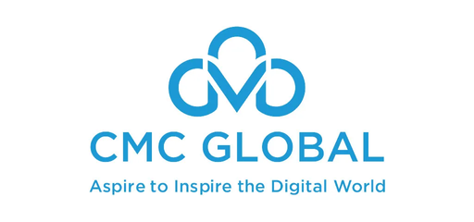
CMC GLOBAL
java
Microservices
Spring Cloud
Tutorials
01.

Slide 2
Table
of contents
1
2
Overview
Spring cloud
Microservices
Spring cloud
3
4
Microservices
Demo
5
6
Notes
Reference
02.

Slide 3
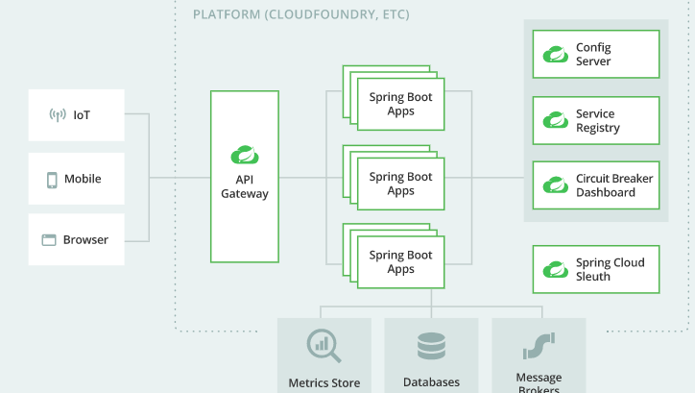
Overview
Nowadays, the technology is developing so quickly and the size of each product grows constantly. So it is hard to maintain as well as to develop it.
Because of that lack of developing large product, the microservices architectural comes in to solve it. In microservices, application code is delivered in small, manageable pieces, independent of others.
Spring also provides lots of supports by Spring cloud which help us develop microserivces more easily.
03.

Slide 4
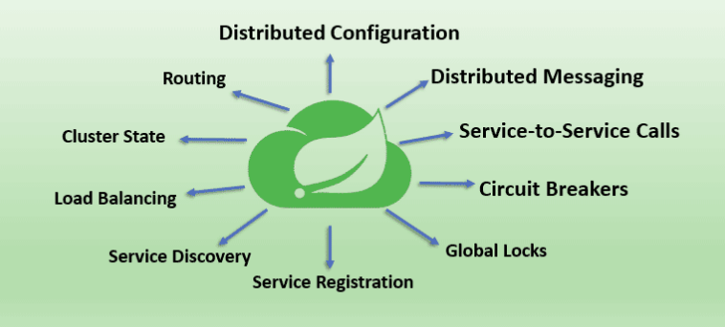
2. Spring cloud
Spring Cloud provides tools for developers to quickly build some of the common patterns in distributed systems (e.g. configuration management, service discovery, circuit breakers, intelligent routing, micro-proxy, control bus, one-time tokens, global locks, leadership election, distributed sessions, cluster state). Using Spring Cloud developers can quickly stand up services and applications that implement those patterns
Spring Cloud is also a very important part in microservices architectural. What we will see in microservices section
04.

Slide 5
2.1 Some main Spring Cloud libraries:
1
Spring Cloud Config
2
Spring Cloud Gateway
Spring Cloud Config provides server and client-side support for externalized configuration in a distributed system. With the Config Server you have a central place to manage external properties for applications across all environments. The concepts on both client and server map identically to the Spring Environment and PropertySource abstractions, so they fit very well with Spring applications, but can be used with any application running in any language
Spring Cloud Gateway aims to provide a simple, yet effective way to route to APIs and provide cross cutting concerns to them such as: security, monitoring/metrics, and resiliency.
3
Spring Cloud Circuit Breaker
4
Spring Cloud Netflix
Spring Cloud Circuit breaker provides an abstraction across different circuit breaker implementations. It provides a consistent API to use in your applications allowing you the developer to choose the circuit breaker implementation that best fits your needs for your app.
Spring Cloud Netflix provides Netflix OSS integrations for Spring Boot apps through autoconfiguration and binding to the Spring Environment and other Spring programming model idioms. With a few simple annotations, you can quickly enable and configure the common patterns inside your application and build large distributed systems with battle-tested Netflix components. The patterns provided include Service Discovery (Eureka).
05.

Slide 6
2.1 Some main Spring Cloud libraries:
5
6
Spring Cloud Kubernetes
Spring Cloud Security
Spring Cloud Security offers a set of primitives for building secure applications and services with minimum fuss. A declarative model which can be heavily configured externally (or centrally) lends itself to the implementation of large systems of co-operating, remote components, usually with a central indentity management service. It is also extremely easy to use in a service platform like Cloud Foundry. Building on Spring Boot and Spring Security OAuth2 we can quickly create systems that implement common patterns like single sign on, token relay and token exchange.
Spring Cloud Kubernetes provides implementations of well known Spring Cloud interfaces allowing developers to build and run Spring Cloud applications on Kubernetes. While this project may be useful to you when building a cloud native application, it is also not a requirement in order to deploy a Spring Boot app on Kubernetes. If you are just getting started in your journey to running your Spring Boot app on Kubernetes you can accomplish a lot with nothing more than a basic Spring Boot app and Kubernetes itself
7
Spring Cloud Sleuth
8
Spring Cloud for Amazon Web Services
Spring Cloud Sleuth provides Spring Boot auto-configuration for distributed tracing.
Sleuth configures everything you need to get started. This includes where trace data (spans) are reported to, how many traces to keep (sampling), if remote fields (baggage) are sent, and which libraries are traced.
Spring Cloud for Amazon Web Services, eases the integration with hosted Amazon Web Services. It offers a convenient way to interact with AWS provided services using well-known Spring idioms and APIs, such as the messaging or caching API. Developers can build their application around the hosted services without having to care about infrastructure or maintenance.
06.

Slide 7
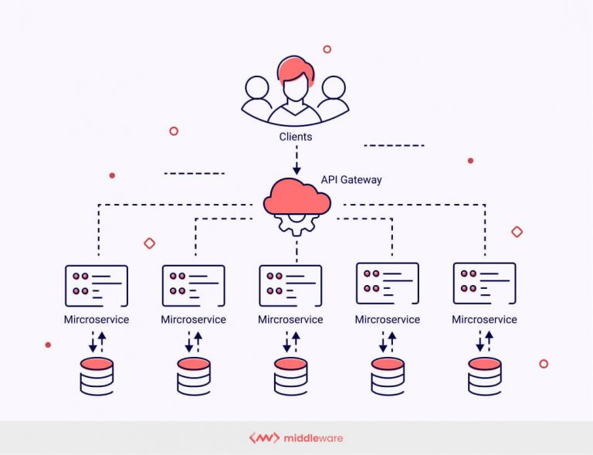
3. Microservices
Microservices are an architectural and organizational approach to software development where software is composed of small independent services that communicate over well-defined APIs. These services are owned by small, self-contained teams.
Microservices architectures make applications easier to scale and faster to develop, enabling innovation and accelerating time-to-market for new features.
Microservices architecture was developed to overcome monolithic architectural approaches to application development challenges and difficulties. To be more specific, Monolithic architecture is like a large container holding all software components of an application: user interface, business layer, and data interface. This had several limitations, including inflexibility, lack of reliability, difficulty scaling, slow development, etc
07.

Slide 8
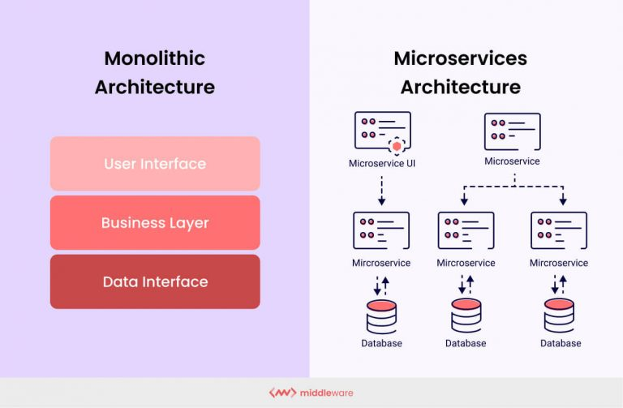
3.1 Microservices vs Monolithic
Unlike Monolithic, Applications running on microservices architecture are deconstructed and separated into smaller units (microservices) that the client can access using an API gateway. These microservices are each independently deployable but can communicate with one another when necessary.
Breaking down an application into microservices allows for faster development, easier bug detection and resolution, smoother maintenance, flexibility, and higher availability and scalability.
08.

Slide 9

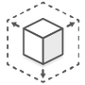
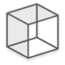



3.3 Microservices characteristic
JobInstance
Flexible Scaling
Reusable Code
Microservices foster an organization of small, independent teams that take ownership of their services. Teams act within a small and well understood context, and are empowered to work more independently and more quickly. This shortens development cycle times. You benefit significantly from the aggregate throughput of the organization.
Microservices allow each service to be independently scaled to meet demand for the application feature it supports. This enables teams to right-size infrastructure needs, accurately measure the cost of a feature, and maintain availability if a service experiences a spike in demand.
Dividing software into small, well-defined modules enables teams to use functions for multiple purposes. A service written for a certain function can be used as a building block for another feature. This allows an application to bootstrap off itself, as developers can create new capabilities without writing code from scratch.
Resilience
Easy Deployment
Technological Freedom
Microservices enable continuous integration and continuous delivery, making it easy to try out new ideas and to roll back if something doesn’t work. The low cost of failure enables experimentation, makes it easier to update code, and accelerates time-to-market for new features.
Microservices architectures don’t follow a “one size fits all” approach. Teams have the freedom to choose the best tool to solve their specific problems. As a consequence, teams building microservices can choose the best tool for each job.
Service independence increases an application’s resistance to failure. In a monolithic architecture, if a single component fails, it can cause the entire application to fail. With microservices, applications handle total service failure by degrading functionality and not crashing the entire application.
09.

Slide 10
3.4 Challenges associated with microservices architecture
Inter-service communication
Distributed logging
Although microservices can exist and function independently, they often need to interact and communicate with other microservices to fulfill certain demands or tasks. This necessitates maintaining a fully functional API serving as a communication channel between multiple services constituting the application.
When different and independently operating microservices are deployed as part of an application, each of these services has a distinct logging mechanism. This results in large volumes of distributed log data that are unstructured and difficult to organize and maintain.
Transaction spanning
Cyclic dependencies between services
Distributed transactions refer to transactions that require the deployment and proper functioning of a series of microservices to run. This means that a transaction spans multiple microservices and databases and a small failure in just one will result in a transaction failure.
A cyclic dependency in a microservices architecture refers to the codependency of two or more application services or modules. Cyclic dependencies can make it difficult to scale the application or independently deploy and manage microservices. They’re also infamous for making code more complex to maintain. If they persist for long, decoupling becomes close to impossible.
11.

Slide 11
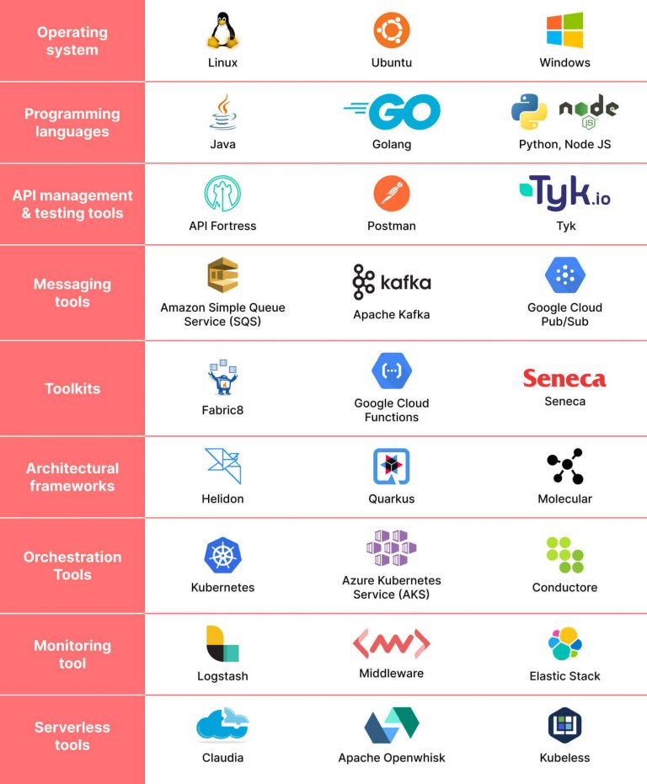
3.5 Microservices tool
Building a microservices architecture requires a mix of tools and processes to perform the core building tasks and support the overall framework. Some of these tools are listed beside.
Using lots of tool means that developer has to comprehend lots of knowledge to build a successful product
In Spring microservices. Spring cloud provides so many libraries to apply to microservices more easily, what we saw in the Spring cloud section
10.

Slide 12






3.6 Top Companies Using Microservices
10.

Slide 13







3.7 The Most Popular Languages In Microservices
JAVA
HTML/CSS
8.9%
JAVASCRIPT
Java
22.8%
TypeScript
10.6%
PYTHON
SQL
HTML/CSS
PHP
11.1%
TYPESCRIPT
PHP
JavaScript
20.6%
SQL
12.2%
Python
13.9%
10.
According to JetBrains figures

Slide 14
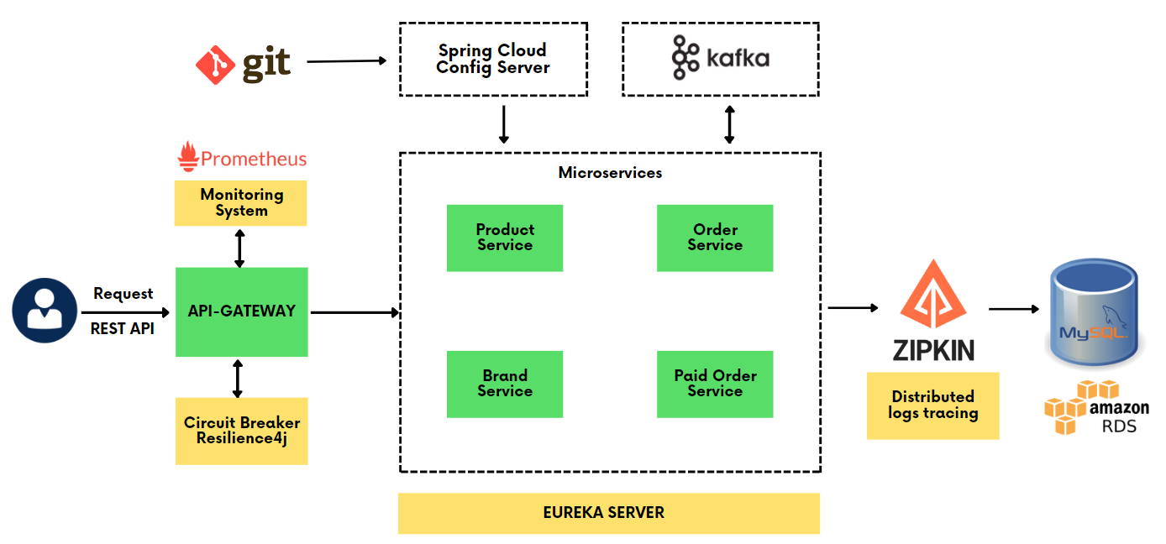
4. Demo
Introduction
We are getting inside a simple example of ordering products with 4 services inside, combining with kafka to get order request from customer.
We will go through each part in detail in next sections
The BrandService is responsible for storing brand information.
The ProductService is responsible for storing product information.
The OrderService is responsible for taking order request from customers. If the order has not been paid, it will save data to database to wait for future payment, else it will transfer data to PaidOrderService to store data for completing order
12.

Slide 15
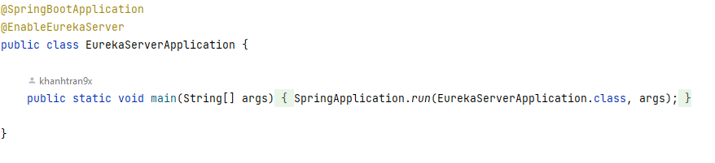
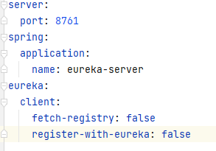
4.1 Eureka server
Eureka Server is an application that holds the information about all client-service applications. Every Micro service will register into the Eureka server and Eureka server knows all the client applications running on each port and IP address. Eureka Server is also known as Discovery Server.
Application.java
In spring, we need to start a new project with netflix-eureka-server dependency
Application.yml
Add annotation @EnableEurekaServer in Application.java
We also need an application.yml inside resources package to config for the server
13.

Slide 16
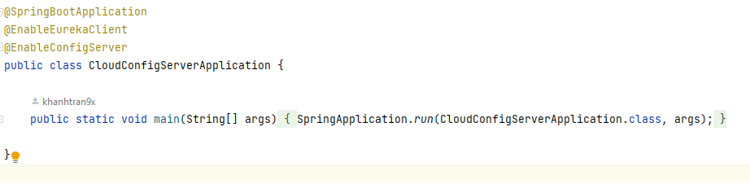
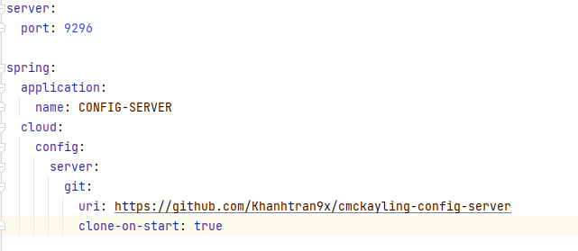
4.2 Cloud Config Server
We will config the way for each client connects to eureka server, but instead of configing it in every clients, we will config it on github then use Cloud Config Server to connect to github. From now on, all clients just need to relate to this Cloud Config Server
Application.java
Start new spring project with dependencies: spring-cloud-config-server and netflix-eureka-client
Application.yml
Add annotation @EnableEurekaClient and @EnableConfigServer in file application.java
Add application.yml within resources package with configuation like the beside image.
As you can see, on uri line, there is a github link, that's where the eureka connect server is config, so now we will create a new repository on github and do it
14.

Slide 17
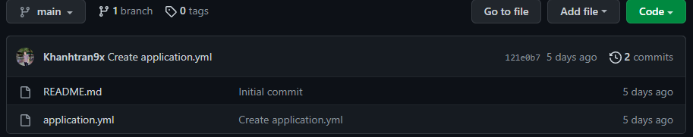
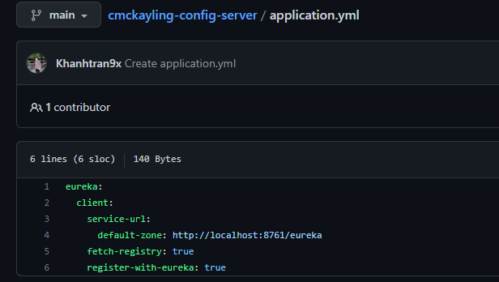
4.2 Cloud Config Server
Create a new github repo then add a new application.yml file
Github repo
Add new data to appication.yml file like the beside image
As you can see, the service-url is exact the one we config in eureka-server
application.yml
Now just copy the repo link and paste it in file application.yml in Cloud Config Server project
15.

Slide 18
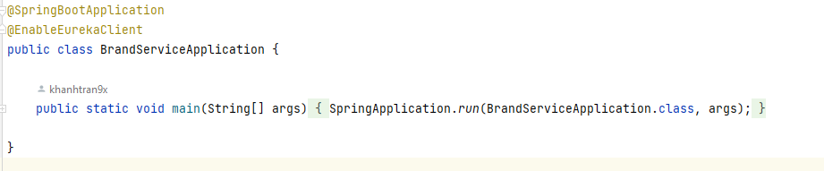
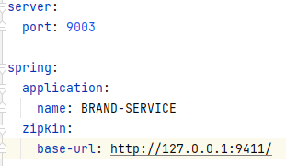
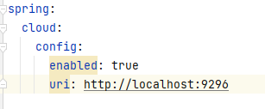
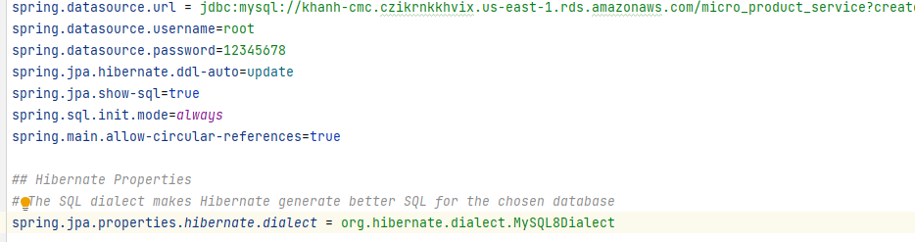
4.3 Brand Service
Application.java
This service is used to store brand information
Start new project with dependencies:
spring-cloud-starter-netflix-eureka-client
spring-boot-starter-data-jpa
spring-cloud-starter-sleuth
spring-cloud-sleuth-zipkin
Add annotation @EnableEurekaClient in file application.java
application.yml
bootstrap.yml
Add application.properties, application.yml and bootstrap.yml within resources package with configuation like the beside image.
As you can see, there is zipkin config for logs and tracing, we will go in detail about this later.
application.properties
16.

Slide 19
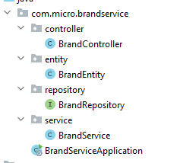
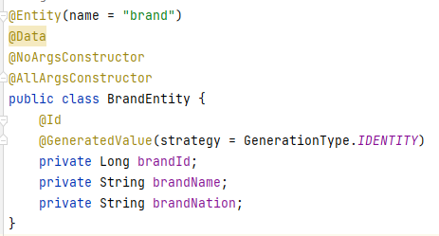
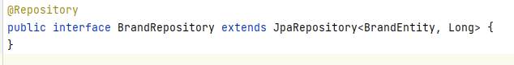
4.3 Brand Service
Add new files like the below tree
BrandEntity
BrandRepository
17.

Slide 20
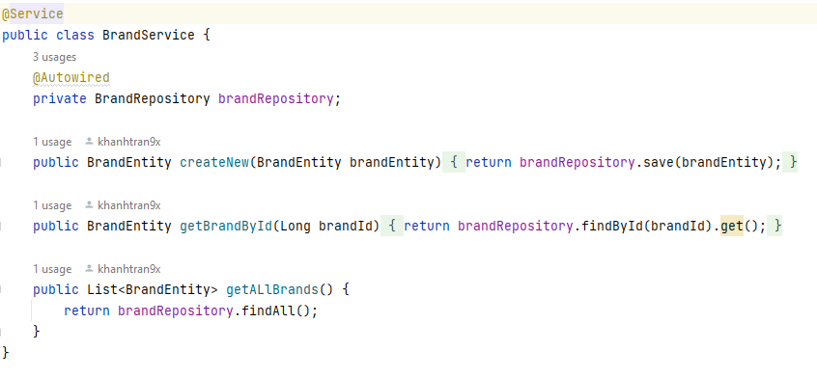
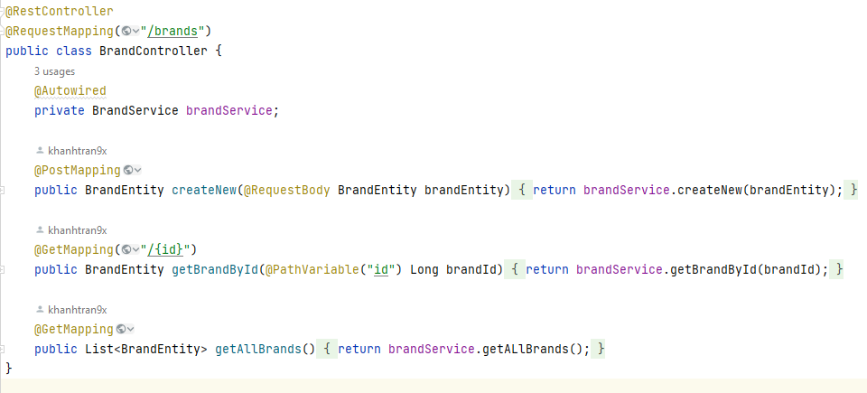
4.3 Brand Service
BrandService
BrandController
18.

Slide 21
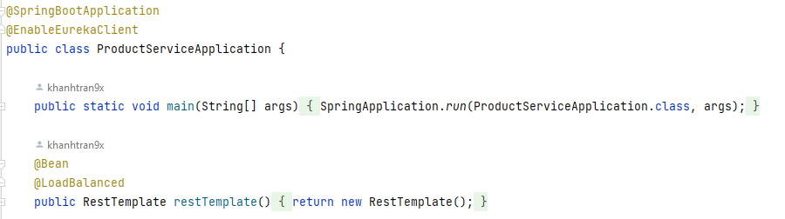
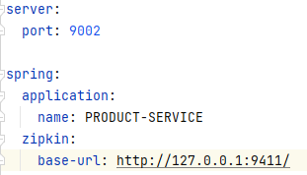
4.4 Product Service
Application.java
This service is used to due with CRUD funtions for storing product information
Start new project with dependencies:
spring-cloud-starter-netflix-eureka-client
spring-boot-starter-data-jpa
spring-cloud-starter-sleuth
spring-cloud-sleuth-zipkin
Add annotation @EnableEurekaClient in file application.java
application.yml
bootstrap.yml
Add application.properties, application.yml and bootstrap.yml within resources package with configuation like the beside image.
As you can see, there is zipkin config for logs and tracing, we will go in detail about this later.
application.properties
19.

Slide 22
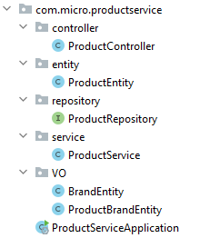
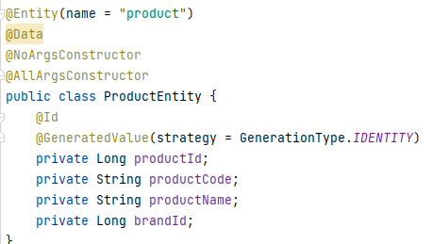
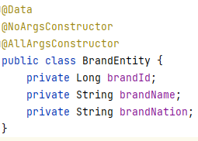
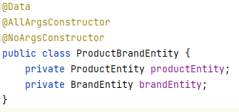
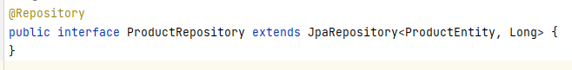
4.4 Product Service
We still have to create some response entities such as BrandEntity and ProductBrandEntity to receive data from BrandService
Add new files like the below tree
ProductEntity
BrandEntity
ProductBrandEntity
ProductRepository
20.

Slide 23
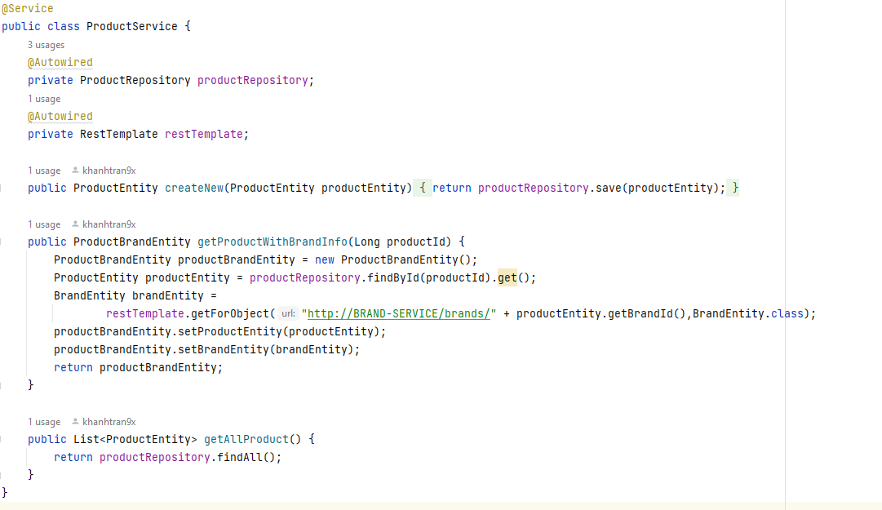
4.4 Product Service
Because ProductService is a eureka client like BrandService, so that they will interact with each other by their spring name instead of their port
ProductService
21.

Slide 24
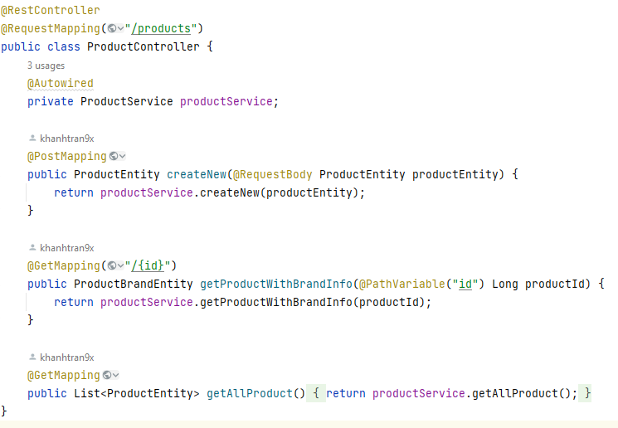
4.4 Product Service
ProductController
22.

Slide 25
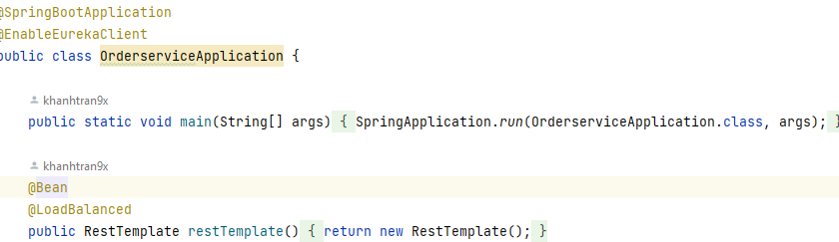
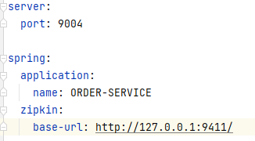
4.5 OrderService
Application.java
This service is used to due with CRUD funtions for ordering product. It uses kafka to
get requests
Start new project with dependencies:
spring-cloud-starter-netflix-eureka-client
spring-boot-starter-data-jpa
spring-cloud-starter-sleuth
spring-cloud-sleuth-zipkin
spring-kafka
application.yml
bootstrap.yml
Add annotation @EnableEurekaClient in file application.java
Add application.properties, application.yml and bootstrap.yml within resources package with configuation like the beside image.
As you can see, there is zipkin config for logs and tracing, we will go in detail about this later.
application.properties
23.

Slide 26
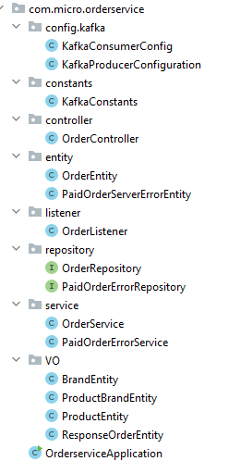
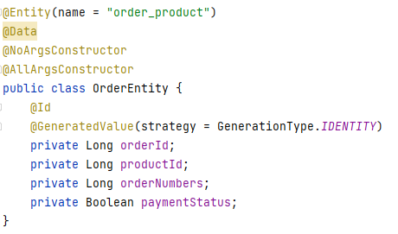
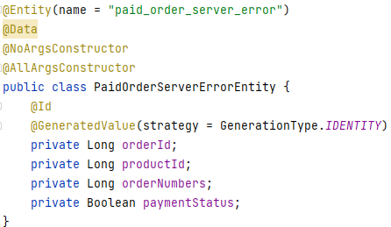
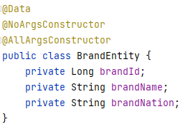
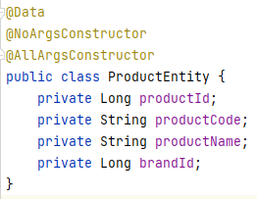
4.5 OrderService
We still have to create some response entities such as ProductEntity, BrandEntity, ProductBrandEntity to receive data from ProductService
Add new files like the below tree
OrderEntity
PaidOrderServerErrorEntity
BrandEntity
ProductEntity
24.

Slide 27
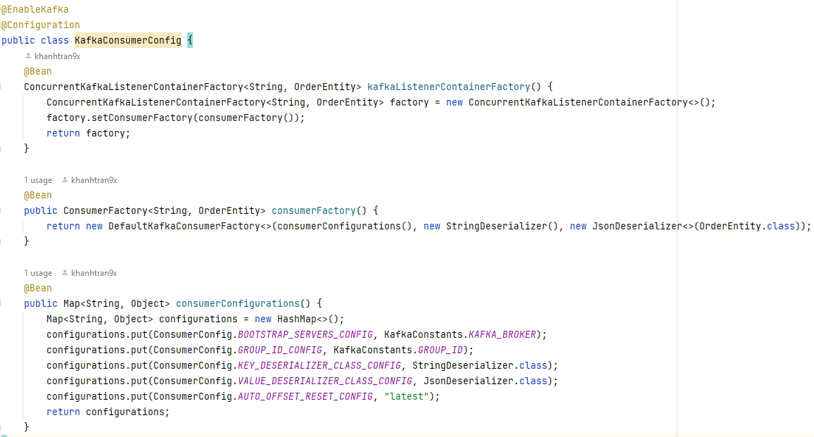
4.5 OrderService - Kafka config
KafkaConsumerConfig
25.

Slide 28
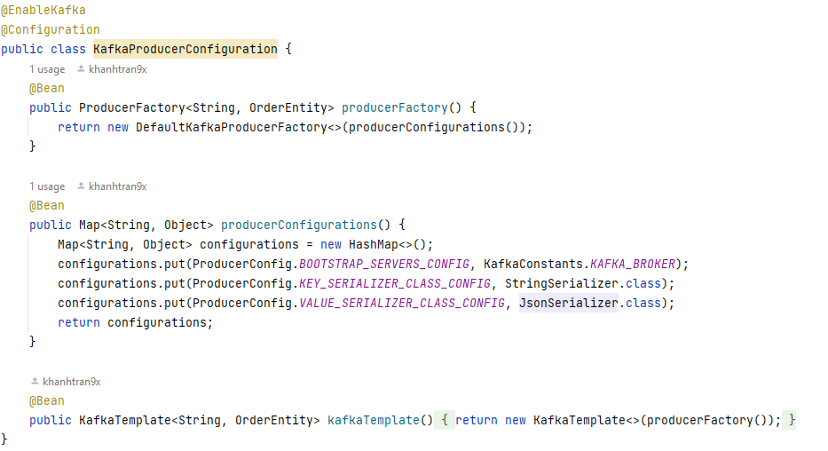
4.5 OrderService - Kafka config
KafkaProducerConfiguration
26.

Slide 29
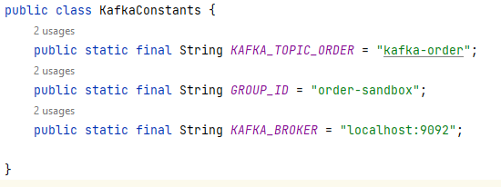
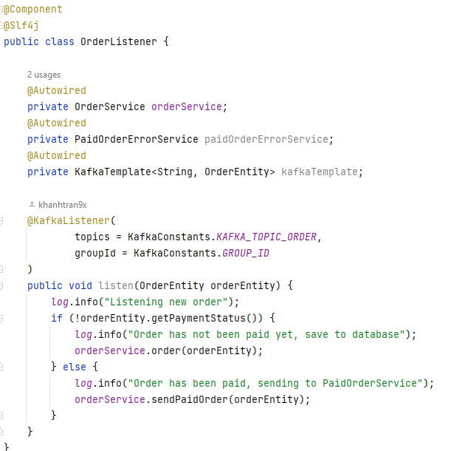
4.5 OrderService - Kafka config
KafkaConstants
KafkaListener
The listener will listen to kafka topic, it will be notified and reiceived data whenever new data coming to kafka topic
If the order has not been paid, it will be saved to order_product table in database, else it will be sent to another service for processing
27.

Slide 30
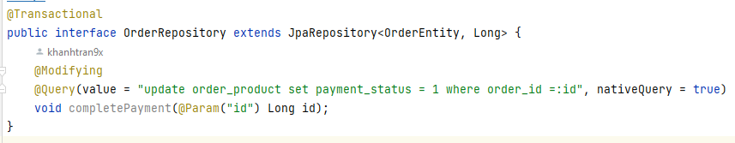
4.5 OrderService
OrderRepository
PaidOrderErrorRepository
28.

Slide 31
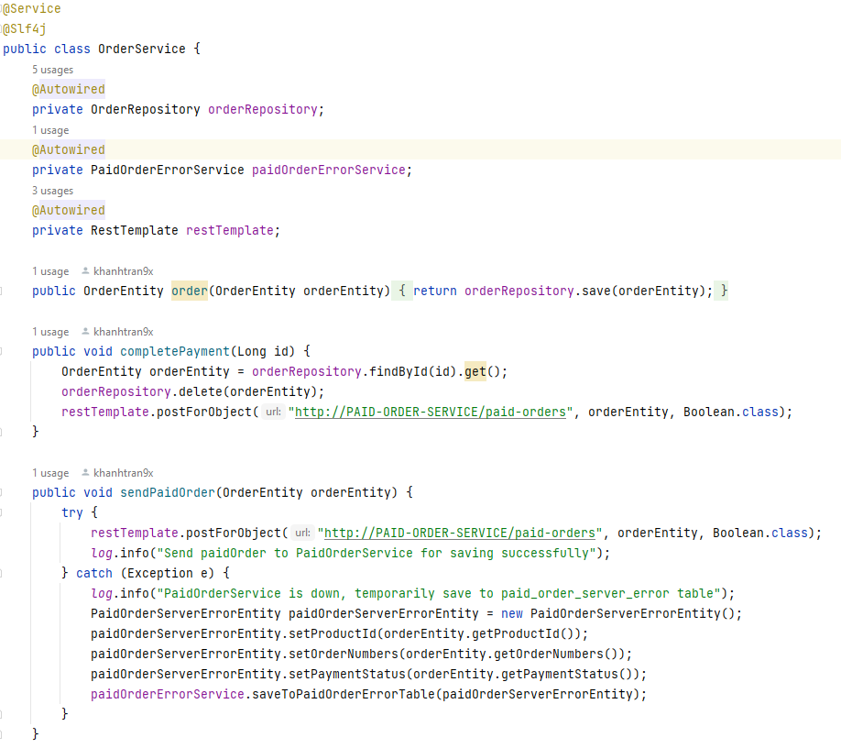
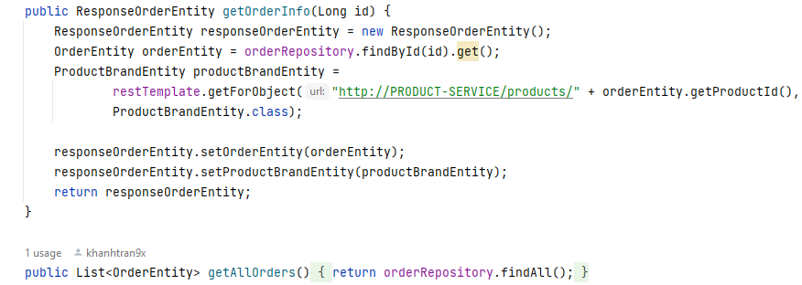
4.5 OrderService
OrderService
29.

Slide 32
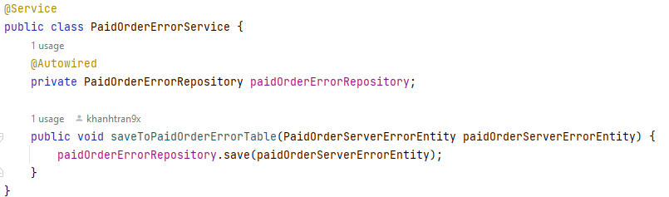
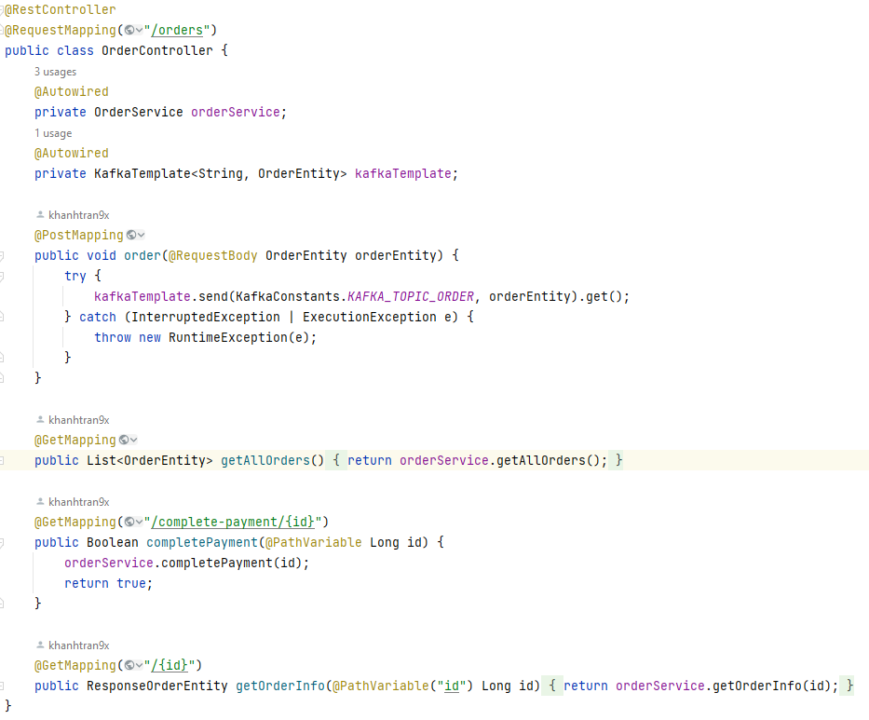
4.5 OrderService
PaidOrderErrorService
OrderController
30.

Slide 33
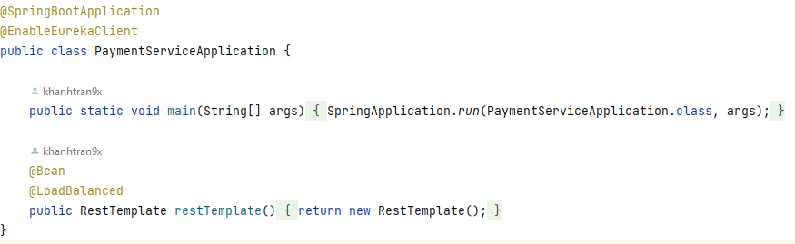

4.6 PaidOrderService
Application.java
This service is used to save paid order. It uses kafka to get requests
Start new project with dependencies:
spring-cloud-starter-netflix-eureka-client
spring-boot-starter-data-jpa
spring-cloud-starter-sleuth
spring-cloud-sleuth-zipkin
spring-kafka
application.yml
bootstrap.yml
Add annotation @EnableEurekaClient in file application.java
Add application.properties, application.yml and bootstrap.yml within resources package with configuation like the beside image.
As you can see, there is zipkin config for logs and tracing, we will go in detail about this later.
application.properties
31.

Slide 34




4.6 PaidOrderService
We still have to create some response entities such as ProductEntity, BrandEntity, ProductBrandEntity to receive data from ProductService
PaidOrderEntity
ProductEntity
Add new files like the below tree file
BrandEntity
ProductBrandEntity
ResponseOrderEntity
32.

Slide 35

4.6 PaidOrderService - Kafka config
KafkaConsumerConfig
33.

Slide 36

4.6 PaidOrderService - Kafka config
KafkaProducerConfiguration
34.

Slide 37


4.6 PaidOrderService - Kafka config
KafkaConstants
KafkaListener
The listener will listen to kafka topic, it will be notified reiceived data whenever new data coming to kafka topic
35.

Slide 38


4.6 PaidOrderService
PaidOrderService
PaidOrderRepository
36.

Slide 39

4.6 PaidOrderService
PaidOrderController
37.

Slide 40

4.6 API-GATEWAY
This is the api-gateway of our microservices, it plays the most important role in the project. It will receive all of the requests from customers then distribute it to the exact service.
It also implements Cicuitebreaker Resilience4j for handling failure and retrying
Application.java
Start new project with dependencies:
spring-boot-starter-actuator
spring-boot-starter-webflux
spring-cloud-starter-circuitbreaker-reactor-resilience4j
spring-cloud-starter-gateway
resilience4j-micrometer
spring-cloud-starter-netflix-eureka-client
bootstrap.yml
Add annotation @EnableEurekaClient in file application.java
Add application.yml and bootstrap.yml within resources package with configuation like the beside image.
38.

Slide 41


4.6 API-GATEWAY
The application.yml will config
the microservice path as well as what it will do when one service is down
application.yml
39.

Slide 42


4.6 API-GATEWAY
CircuitBreakerConfiguration
FallbackConfiguration
The idea of circuit breakers is to prevent calls to a remote service if we know that the call is likely to fail or time out. We do this so that we don’t unnecessarily waste critical resources both in our service and in the remote service. Backing off like this also gives the remote service some time to recover.
40.

Slide 43


4.7 Zipkin
Zipkin is a distributed tracing system. It helps gather timing data needed to troubleshoot latency problems in service architectures. Features include both the collection and lookup of this data.
You first need to install zipkin on your OS via this tutorial: https://zipkin.io/pages/quickstart.html
Next, run it and get the IP address
Next, copy IP address then paste it to the application.yml file of each service
41.

Slide 44

4.8 Running
Run kafka server and zippkin server first
Run Eureka Server next so that other services can connect to it when they run
Run the rest services then go to http://localhost:8761/ to check if there is enough services connecting to eureka server
Now send request to services, the prefix api url has to be http://localhost:9191/**
Now you can see what request that you made in zippkin dashboard via the url: http://127.0.0.1:9411/zipkin/
42.

Slide 45
4.8 Conclusion
This is a small demo for us to understand the microservices architectural and build a good knowledge foundation, but it still convers enough what it is needed for a microservices project
Microservices are getting hot nowadays so it's good to start right away
Microservices comes with a great benefit for a large system. Here, developers can work on their independent modules without too much dependency. And if a server goes to down it will not down the whole system.The source code for this demo is available on GitHub.
https://github.com/Khanhtran9x/khanh-cmc-researching/tree/main/micro-services/cmc-product-services
43.

Slide 46
5.0 Microservices and Spring Cloud Notes
Config the right version. There are so many libraries to due with spring cloud and microservices, so sometimes it will become headache for you to choose the right version of each library that it can run well with others
Undestanding the flow greatly. Because, there are so many things, many services needed to care in microservices architectural, we need to know exactly which one will do what
Do not abuse microservices. If we divide project into so many microservices, it will take so much time to config, so think carefully before creating any services if we can combine them in one service
Update new technology constantly. The technologies used for microservice are numberous and been developed day by day. So that we have to update it ASAP to adapt and make our product better
44.

Slide 47
6.0 Reference
Demo microservices: https://github.com/Khanhtran9x/khanh-cmc-researching/tree/main/micro-services/cmc-product-services
Spring cloud docs: https://spring.io/projects/spring-cloud
Microservices docs: https://microservices.io/
45.

Slide 48

CMC GLOBAL
java
THANK YOU
If you have any questions at all
Don't hesitate to ask.
tvkhanh1@cmcglobal.vn
46.

